Slide 1

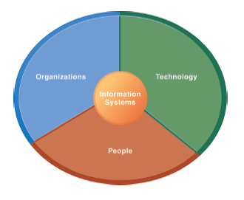
The Institute of Finance Management
ITU08117:
Information Systems Management
BAIT III
Mugyabuso, M. L
2023-2024
Notes:
There are two video cases and two instructional videos available for this chapter.

Slide 2
IS Strategy

Slide 3
1. Information and communication technologies
Information and communication are integral to human society.
More recent technological innovations increased further the reach and speed of communication, culminating, for now, with digital technology

Slide 4
These new ICTs can be grouped into three categories:
Information technology uses computers, which have become indispensable in modern societies to process data and save time and effort
Telecommunications technologies include telephones (with fax) and the broadcasting of radio and television, often through satellites
Networking technologies, of which the best known is the internet, but which has extended to mobile phone technology, Voice Over IP telephony (VOIP), satellite communications, and other forms of communication that are still in their infancy.

Slide 5
2. IT Strategy
Strategy Definitions
Quinn
Pattern or plan that integrates organization’s major goals, policies and actions into cohesive whole
Strategic decisions
Those that determine direction, goals, limits, use of key resources

Slide 6
Purpose
To position or set direction within environment
To focus effort within the organization
To define the organization, to give meaning to the organization’s activities
To provide consistency
For efficiency & focus

Slide 7
Thinking Strategically
1. Where are we now -- what is our situation?
2. Where do we want to go?
3. How will we get there?

Slide 8

What Is Strategy?
Concept
Competitive moves and business approaches management employs in running a company
Management’s “game plan” to
Please customers
Position a company in its chosen market
Compete successfully
Achieve good business performance

Slide 9
How strategies are developed?
It is suggested that we take these steps
Step 1: Understand what the business is trying to achieve. ...
Step 2: Understand what the information needs of the business are. ...
Step 3: Assess the status quo. ...
Step 4: Review and consolidate. ...
Step 5: Define an enterprise architecture.

Slide 10
Step 1: Understand what the business is trying to achieve. ...
Understand the business strategy and key drivers for the organization.
Define/understand the internal processes and people-related issues to correctly align them within the overall strategy.
Establish the context for the Information System needs, and provides the understanding for why certain information is required.

Slide 11
Step 2: Understand what the information needs of the business are. ...
Identifying and understanding the main functional areas of the business and the major business processes that are needed for the business to operate.
Identify key stakeholders who have a vested interest in the information and enable further detailed discussions as to what the information is used for.

Slide 12
Step 3: Assess the status quo. ...
Understand where you are now.
Understand what’s currently in place both from a systems perspective and a data perspective.
the key functions that are performed within the systems; and how the data is used.
Produce a systems map and a data map that shows the current picture, highlighting data/information gaps, duplication, inefficiencies, and potential areas for inaccuracies.

Slide 13
Step 4: Review and consolidate. ...
Taking the current picture, understanding the overlaps, the gaps and the current and future information needs of the business.
Identify areas to consolidate, change and improve.
This involves identifying areas where:
Data is duplicated, Data is missing, Data is inconsistent, Systems are not performing, Manual processes are in place, Location of integration points with third parties

Slide 14
Step 5: Define an enterprise architecture.
The final step is bringing all that information together to define an overall conceptual enterprise architecture which identifies the core systems categorized by function.
The mechanisms by which users will access the data and analytics in the systems.
Workflows to map the business processes.
Data orchestration to maintain data integrity and greater business intelligence suites to provide management information and operational reporting.
Ultimate aim is to provide a conceptual future vision for an information systems structure to support the requirements of the organization.

Slide 15
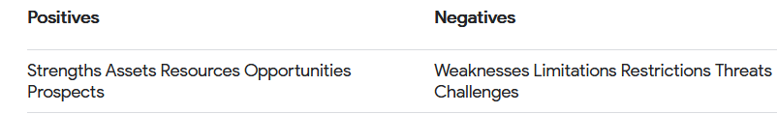
Strategic Planning Tools
SWOT Analysis
is a framework for identifying and analyzing an organization's strengths, weaknesses, opportunities, and threats.
The primary goal of SWOT analysis is to increase awareness of the factors that go into making a business decision or establishing a business strategy.

Slide 16
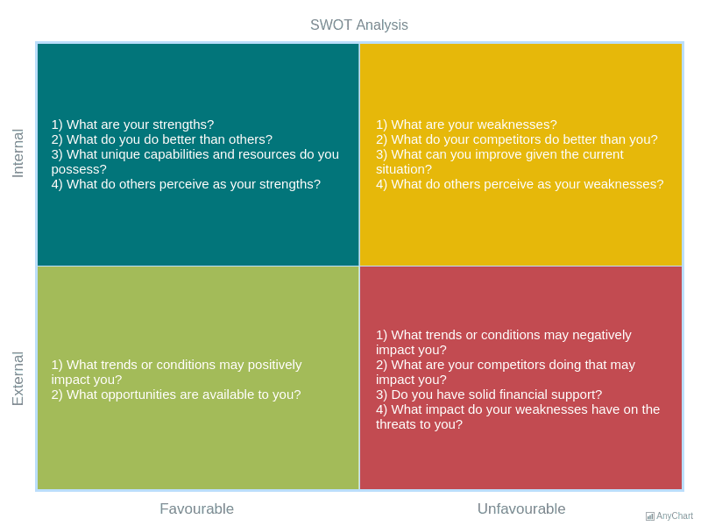

Slide 17
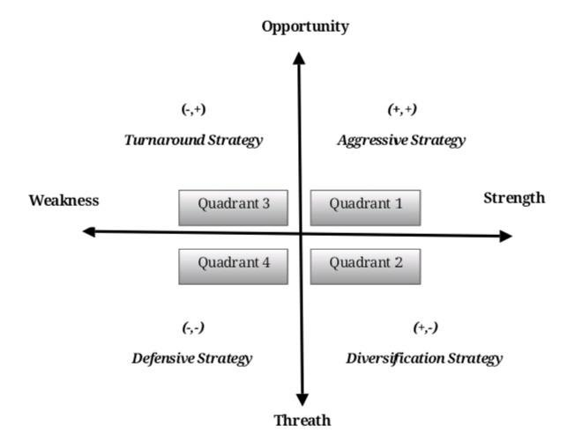

Slide 18
Strategic Planning Tools
scenario planning
A strategic planning methodology that generates plausible alternative futures to help decision-makers identify actions that can be taken today to ensure success in the future

Slide 19
A DEFINITION OF STRATEGY
Strategy is the direction and scope of an organization over the long term which achieves an advantage for the organization through its configuration of resources within a changing environment to meet the needs of markets and to fulfill stakeholder expectations.

Slide 20
ADDITIONAL INFOR….

Slide 21
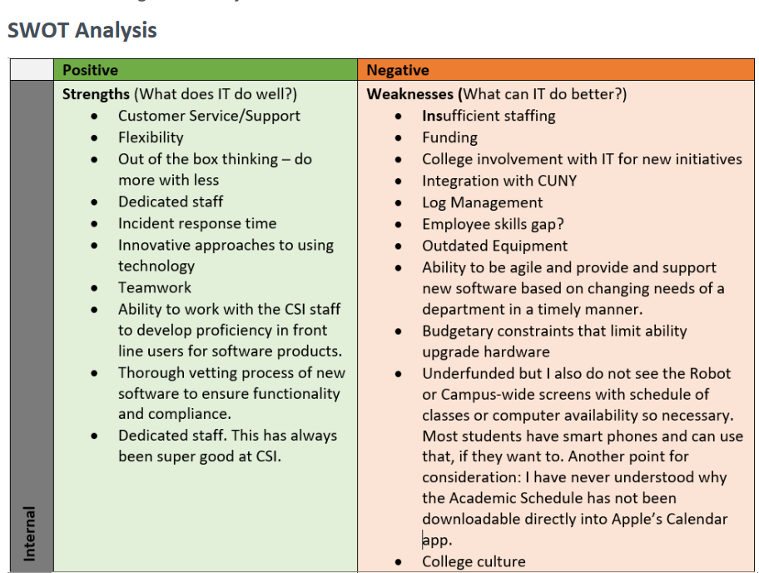

Slide 22
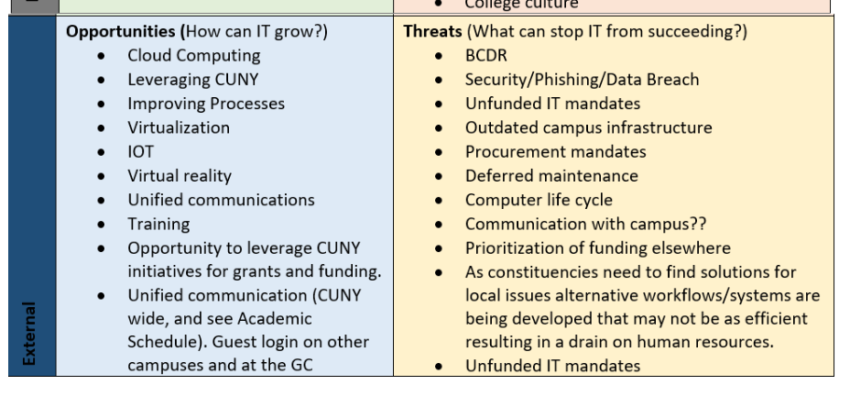

Slide 23
Three - level IT Strategy
IS Strategy
Division/SBU/function based
Demand oriented
Business focused
Applications
What?
IM Strategy
Wherefore?
Organisation based
Relationships oriented
Management focused
Management
IT Strategy
How?
Activity based
Supply oriented
Technology focused
Delivery
Source: Earl

Slide 24
A summary model of the elements of strategic management
Expectations and purposes
Expectations
and purposes
The
environment
Resources,
competences
and capability
Strategic
analysis
Bases
of strategic
choice
Organisation
structure and
design
Strategic
choice
Strategy
implementation
Strategic
options
Resource
allocation and
control
Strategy
evaluation and
selection
Managing
strategic
change

Slide 25
A Multiple Methodology
Business plans
and goals
Current systems
IT opportunities
Analytical
Evaluative
Creative
Top
down
Bottom
up
Techniques,
processes and
environment
Methodology
Surveys and
audits
Inside
out
Teamwork
Users and
specialists
Brightsparks
and product
champions
Application strategic plan

Slide 26
NEXT
Aligning Business and IT

